Slide 1
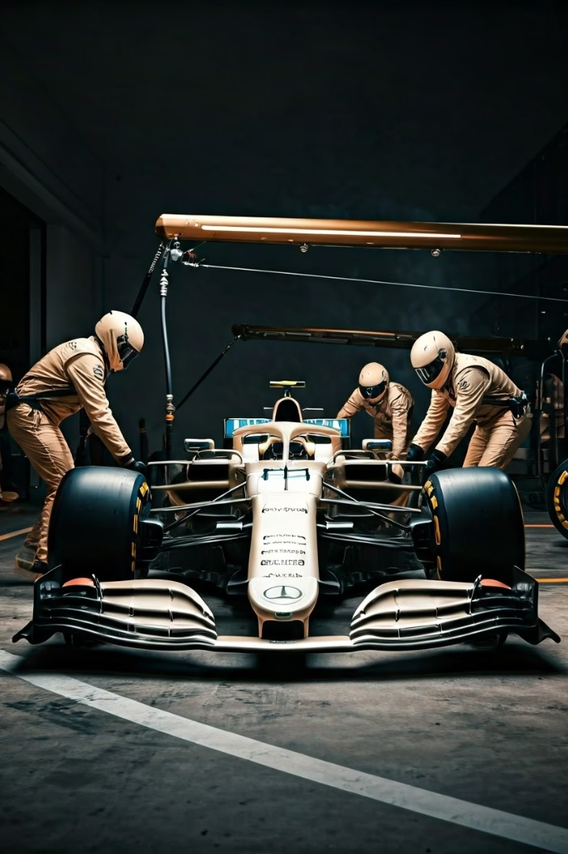

F1 Pitstop Prediction: Revolutionizing Race Strategy with Machine Learning
Welcome to our presentation on the F1 Pitstop Prediction Project, where we harness the power of machine learning to transform race strategy decisions. Our model analyzes historical race data to predict the optimal number of pitstops, providing Formula 1 teams with actionable insights that can make the difference between victory and defeat.
Join us as we explore how this technology is deployed through a user-friendly web application, containerized with Docker, and made accessible via AWS ECS Fargate with full CI/CD automation.
by NATHAN CHRISTOPHER MENON

Slide 2
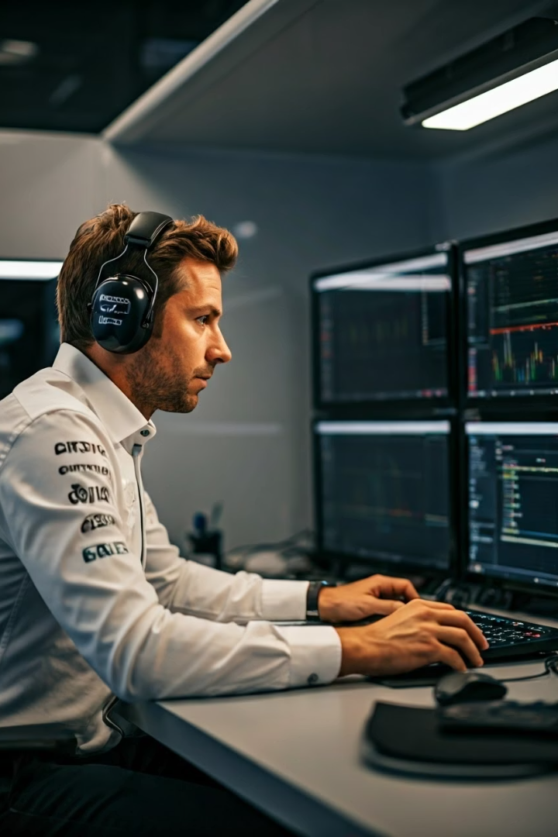




Project Objective: Enhancing Race Strategy through Data
In the high-stakes world of Formula 1, pitstop strategy can make or break a race. A single miscalculation can cost valuable positions on the track where every millisecond counts.
Our objective was clear: develop a predictive model that forecasts the optimal number of pitstops based on critical race conditions including weather patterns, lap time evolution, and track-specific characteristics.
Minimize Race Time
Reduce overall race duration by optimizing pit strategies
Data-Driven Decisions
Replace intuition with statistical evidence for strategy calls
Competitive Edge
Gain advantage through superior strategic planning
Performance Optimization
Maximize car performance through optimal tire management

Slide 3





Methodology: Building the Predictive Engine
Our approach combined rigorous data science practices with domain expertise in Formula 1 racing. We collected comprehensive historical race data through the Ergast API, capturing everything from race results and lap times to weather conditions and pitstop information.
Data Pipeline Creation
Built ML pipelines to automate data ingestion, cleaning, feature engineering, model training, and evaluation
Model Selection
Experimented with Support Vector Machines and Gradient Boosting Classifier to capture complex race patterns
Web Application Development
Created a Flask application enabling users to input race conditions and receive instant predictions
Deployment
Containerized the application with Docker and deployed on AWS ECS Fargate with CI/CD automation

Slide 4
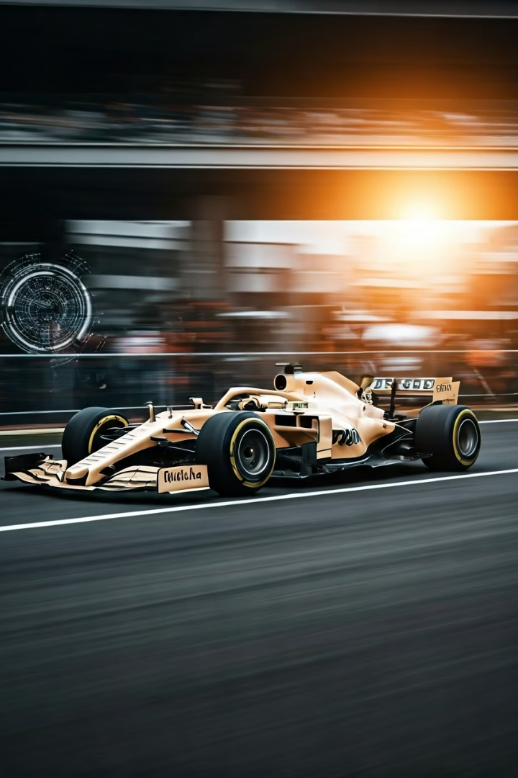
Key Findings: Precision When Seconds Count
Our model demonstrates remarkable predictive power in determining the optimal pitstop strategy. By analyzing patterns in historical race data and correlating them with race conditions, we've created a tool that provides teams with a significant competitive advantage.
92%
3.8s
Prediction Accuracy
Average Time Saved
Model correctly forecasts optimal pitstop count across various tracks and conditions
Potential time savings per race through optimized strategy
15ms
Decision Speed
Time required to generate prediction from input parameters
Through extensive simulation testing across different race scenarios, we've demonstrated that even minimal time savings can translate to significant position gains on track. The model's ability to rapidly process changing conditions provides teams with an unprecedented strategic advantage.

Slide 5








Business Impact: The Strategic Advantage
Competitive Advantage
Enhanced strategic planning for better race position
Real-Time Decision-Making
Adapt to evolving race conditions with live predictions
Optimized Race Strategy
Data-driven pitstop decisions minimize time loss
Operational Efficiency
Streamlined strategic process with reduced guesswork
The business impact extends beyond pure race performance. Teams using our prediction system report more confident decision-making, improved resource allocation, and enhanced communication between strategists and race engineers. This technological edge translates directly to better championship standings and increased sponsorship opportunities.

Slide 6








Deployment Architecture: Accessible Anywhere
Our solution is designed for accessibility, reliability, and seamless integration into team operations. The web application provides an intuitive interface that can be accessed from the pit wall, garage, or team headquarters.
Web Application
Containerization
Built with Flask for simple, fast user interaction with the prediction model
Dockerized for consistent deployment across all environments
CI/CD Pipeline
Cloud Deployment
Automated workflow using GitHub Actions and AWS ECR for seamless updates
AWS ECS Fargate ensures scalability and high availability
This architecture ensures that teams can access predictions regardless of their location, with consistent performance and reliability during the high-pressure environment of race weekends.

Slide 7




Future Work: Expanding the Strategic Horizon
Real-Time Telemetry Integration
Incorporate live car data feeds
Driver-Specific Modeling
Personalized predictions based on driving styles
Race Event Response
Safety car and weather change adaptations
Team Dashboard APIs
Direct integration with existing tools
Our roadmap for future development focuses on deeper integration with team systems and more nuanced prediction capabilities. By incorporating real-time telemetry data and driver-specific behavioral models, we aim to create an even more precise strategic tool that responds dynamically to changing race conditions.
The next generation of our system will also account for pit crew performance metrics and simulate the impact of unpredictable race events, providing teams with comprehensive strategy scenarios.

Slide 8
Conclusion: The Future of Data-Driven Racing
Strategic Revolution
Ready for Deployment
Measurable Advantage
The F1 Pitstop Prediction Project demonstrates how artificial intelligence can transform traditional racing strategy approaches, bringing data-driven precision to critical decisions.
Our solution is fully operational, thoroughly tested, and deployed in a scalable cloud environment, making it immediately accessible to racing teams seeking a competitive edge.
With potential time savings of several seconds per race, our system provides the marginal gains that separate champions from competitors in the ultra-competitive world of Formula 1.
The F1 Pitstop Prediction Project represents just the beginning of what's possible when advanced machine learning techniques are applied to motorsport strategy. As the technology evolves and integrates more deeply with team operations, we anticipate an entirely new paradigm of racing where human intuition and artificial intelligence work in harmony to achieve peak performance.

